Slide 1

Global Video Games Sales Analysis Dashboard
Tool Used: Microsoft Power BI
This project analyzes global video game sales performance using an interactive Power BI dashboard.
by: SathishKumar A

Slide 2
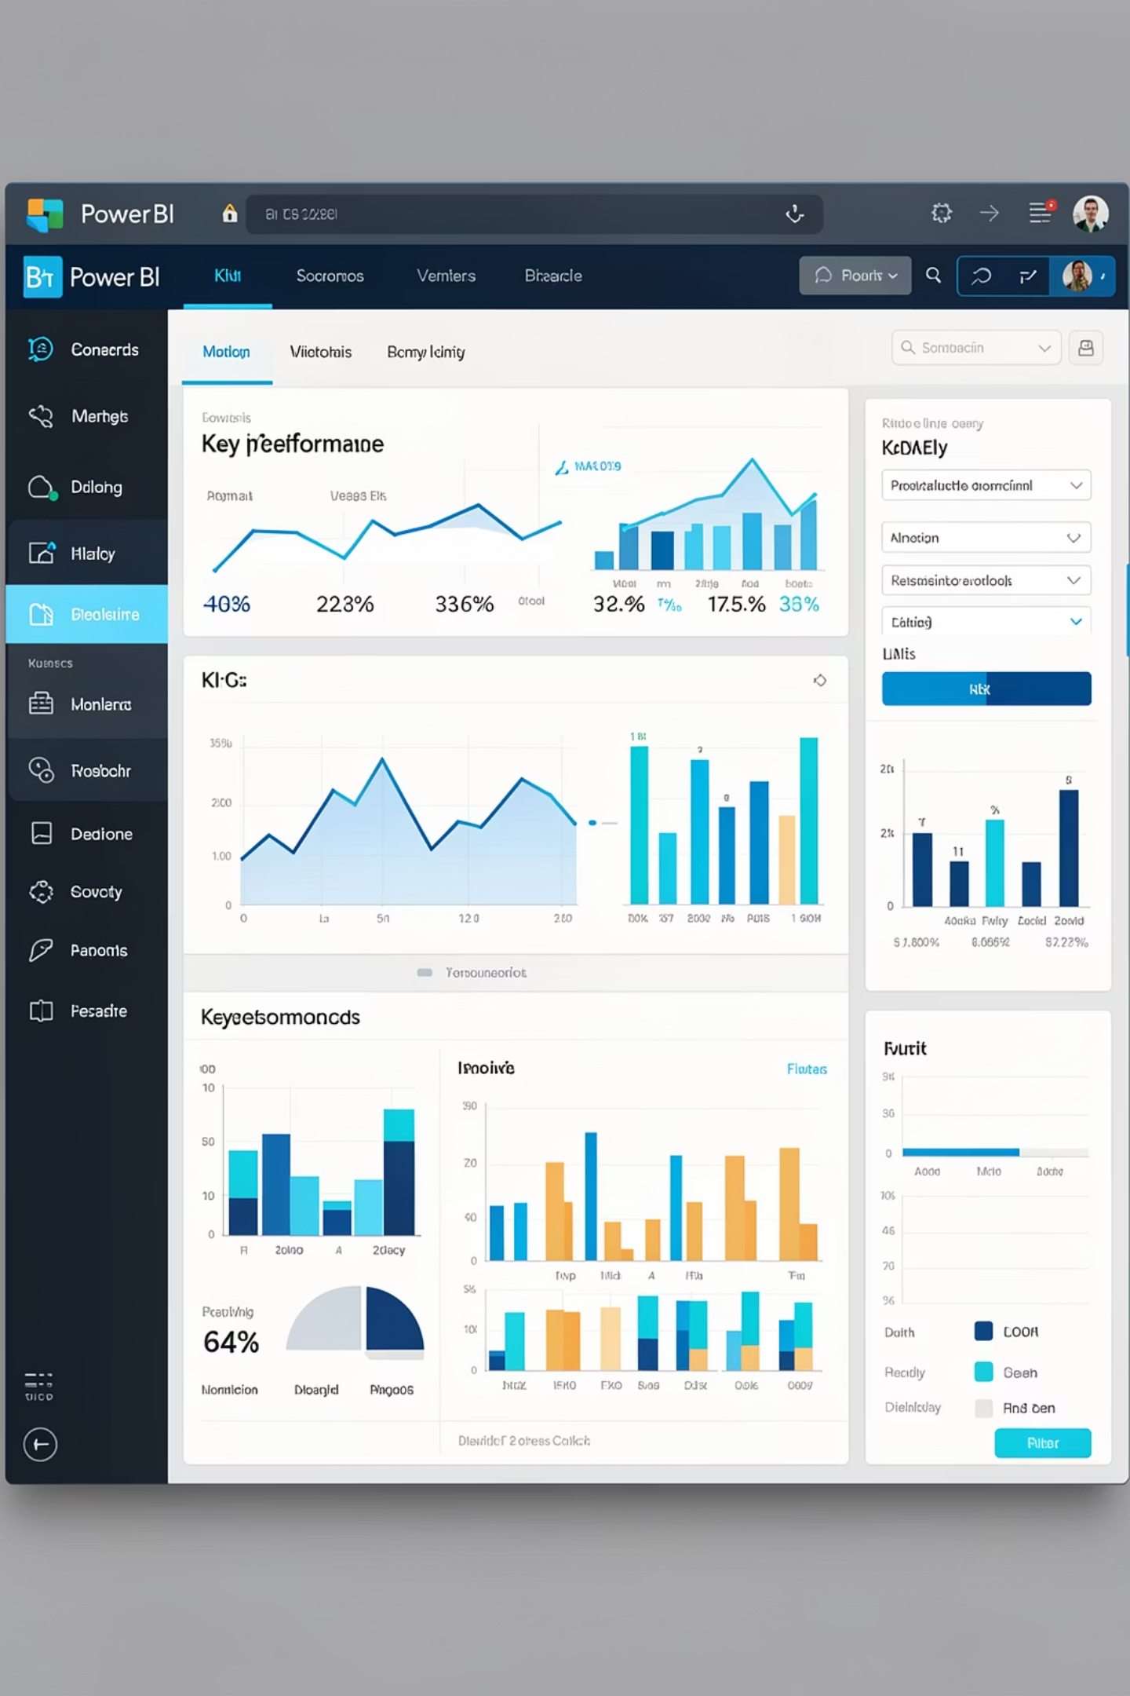
The global video game industry generates vast amounts of sales data across multiple genres, platforms, and years.
Analyzing this data using traditional methods is time-consuming and inefficient.
Stakeholders face difficulty in:
Identifying top-performing genres and platforms
Tracking revenue and units sold trends over time
Comparing performance across different market segments
Problem Statement
The global video game industry generates vast amounts of sales data across multiple genres, platforms, and years.
Analyzing this data using traditional methods is time-consuming and inefficient.
Stakeholders face difficulty in:
Identifying top-performing genres and platforms
Tracking revenue and units sold trends over time
Comparing performance across different market segments
There is a need for a centralized, interactive dashboard to analyze video game sales effectively.

Slide 3

Key Performance Indicators (KPIs)
The top section of the dashboard displays summary KPIs:
10.13T
2.82B
273
Total Revenue
Total Units Sold
Total Games
8.49B
Average Revenue per Game
These KPIs provide an overall snapshot of the video game market.

Slide 4
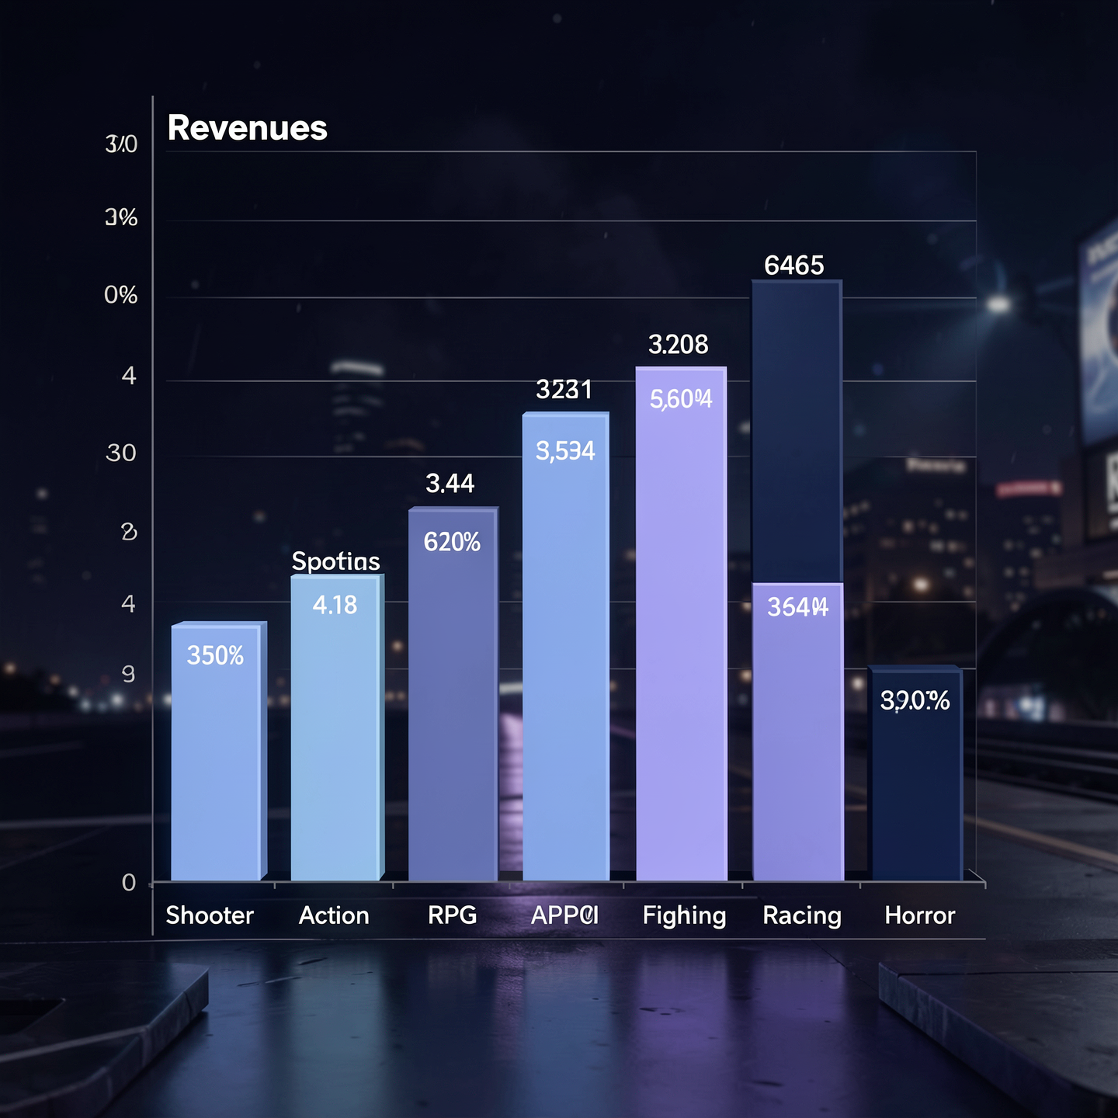
Revenue by Genre Analysis
Revenue by Genre
Shooter genre generates the highest revenue.
Action-Adventure and Sports genres also perform strongly.
RPG and Fighting genres show moderate contribution.
Racing and Horror genres generate lower revenue.
👉 Helps identify the most profitable game genres.

Slide 5

Revenue by Platform Analysis
Revenue by Platform
Revenue is distributed across multiple platforms:
PlayStation (PS4, PS5)
Xbox (Series X, Xbox One)
PC
Nintendo Switch
Platform performance is well balanced.
Highlights importance of multi-platform releases.

Slide 6
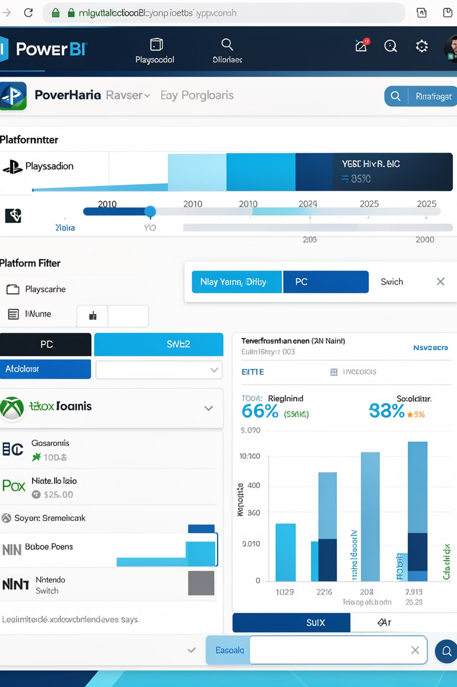
Year Filter and Platform Slicer
Visuals: Year Slider & Platform Filter
Year filter allows analysis from 2010 to 2025.
Platform slicer enables focused platform-wise insights.
All visuals dynamically update based on selection.
👉 Improves interactivity and focused analysis.

Slide 7
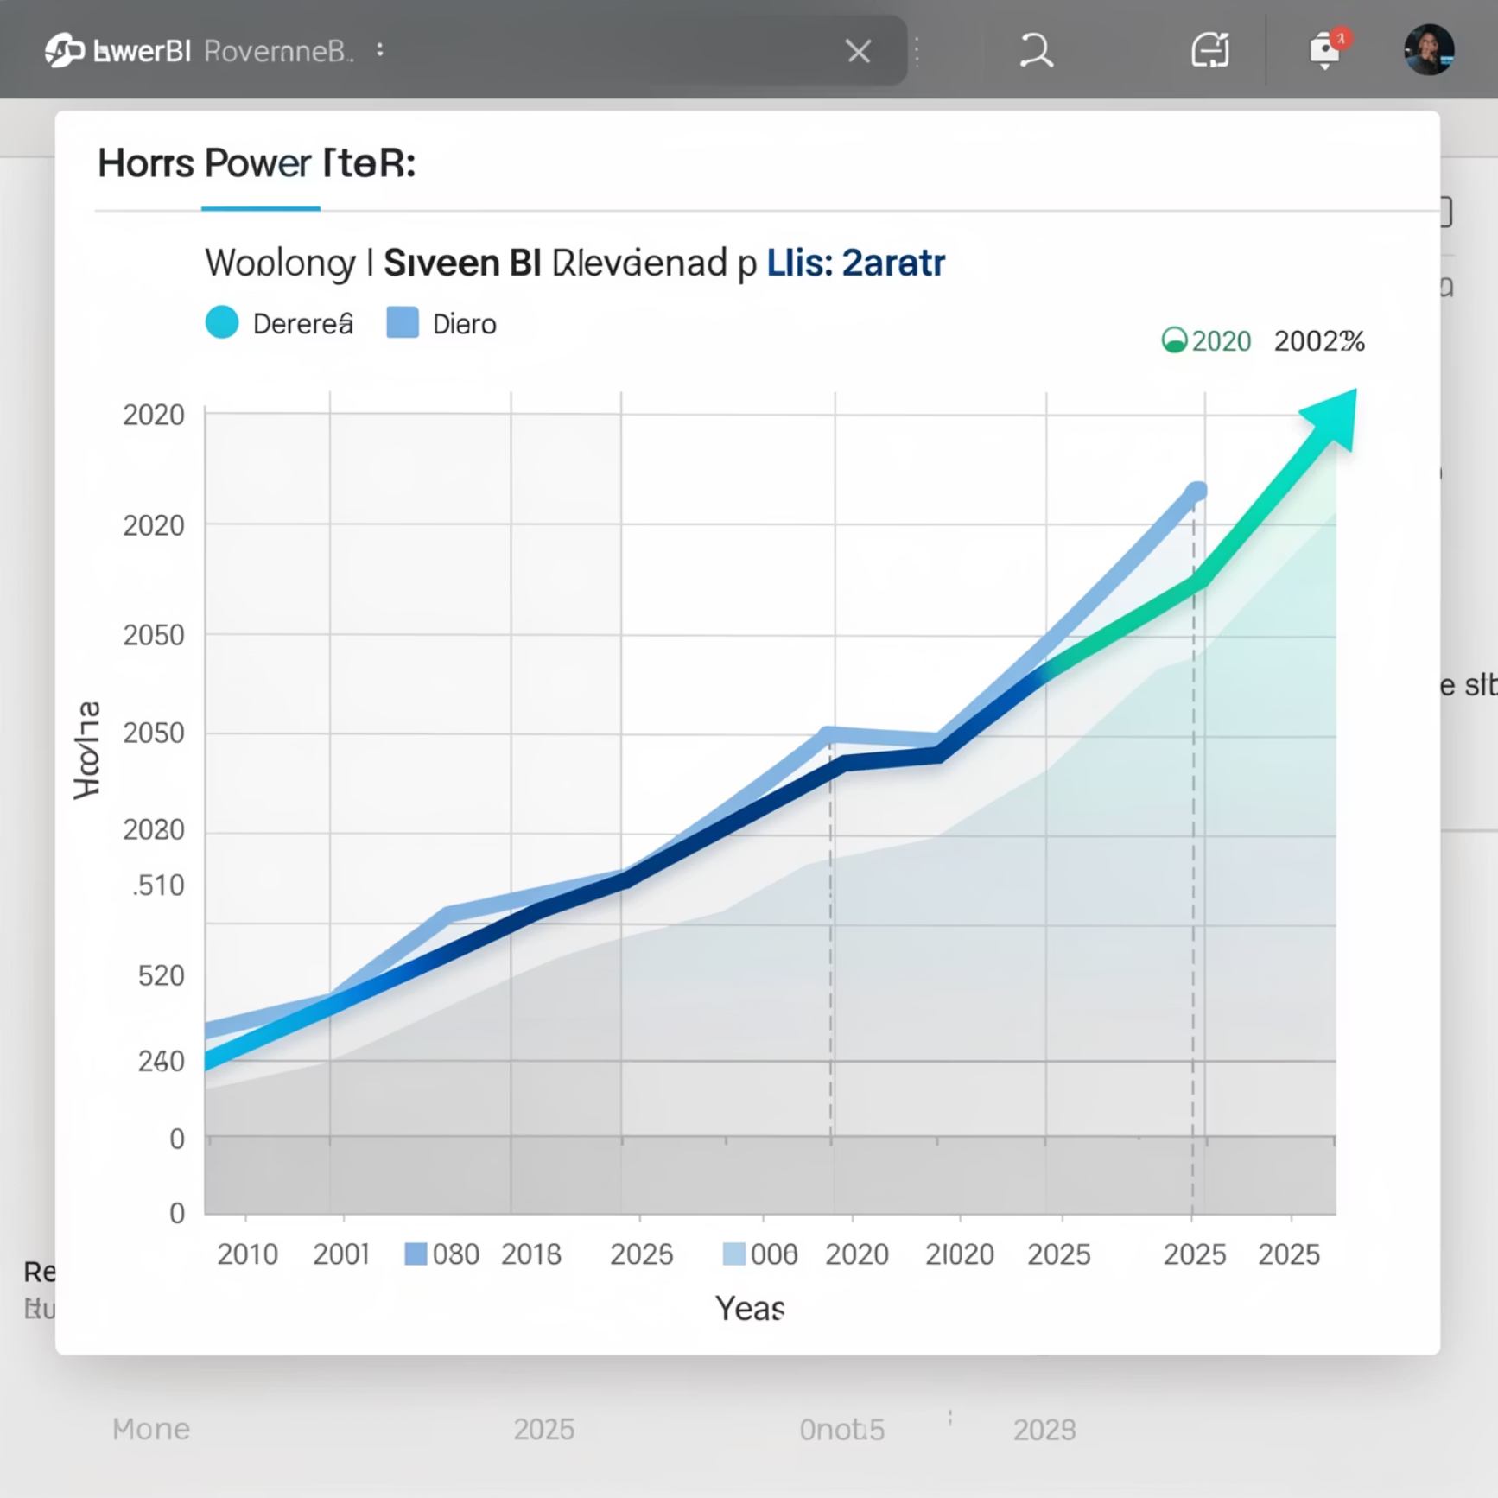
Revenue Trend by Year
Revenue Trend by Year
Revenue shows fluctuations over the years.
Steady growth observed after initial years.
Sharp increase visible in recent years.
Indicates growing demand in the gaming industry.

Slide 8
Sales Performance Insights
High total revenue
Large number of units sold
Indicates strong global market.
Reflects wide consumer reach.
High average revenue per game
Action and Shooter genres
Shows strong monetization.
Dominate sales performance.

Slide 9




Business Use Cases
Publisher Investment
Launch Strategies
Helps publishers decide which genres to invest in.
Supports platform-based launch strategies.
Market Analysis
Automated Reporting
Useful for market trend and performance analysis.
Reduces manual reporting through automated visuals.

Slide 10

Conclusion
Power BI effectively visualizes global video game sales data.
The dashboard combines KPIs, trends, and comparisons.
Interactive filters enhance analytical flexibility.
This project demonstrates strong data visualization and business analytics skills.

